Slide 1
Fuzzy Logic

Slide 2
How reasoning takes place with fuzzy sets
Fuzzy models or sets are mathematical means of representing vagueness and imprecise information hence the term fuzzy.
Fuzzy Logic (FL) is a method of reasoning that resembles human reasoning. It is similar to how humans perform decision making. And it involves all intermediate possibilities between YES and NO.

Slide 3
Fuzzy Logic is a computing approach that is based on “Degree of Truth” and is not limited to Boolean “true or false”.
The fuzzy Logic system is applied to scenarios where it is difficult to categorize states as a binary “True or False”.
Fuzzy Logic can incorporate intermediate values like partially true and partially false.
It tries to mimic human-like decision making, which can incorporate all values in between True and False.

Slide 4
Fuzzy logic helps to solve a problem after considering all available data. Then it takes the best possible decision for the given the input.
Fuzzy theory has the capability to capture the impreciseness of linguistic terms in statements of natural language. This provided with a greater capability to model human common-sense reasoning and decision making .The Fuzzy logic works on the levels of possibilities of input to achieve a definite output.

Slide 5
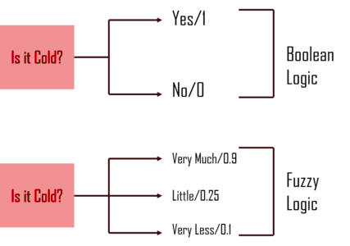
Difference with Boolean Logic

Slide 6
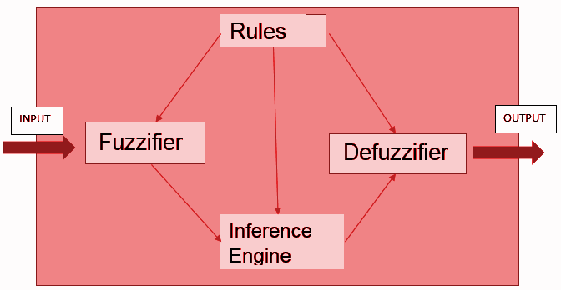
Fuzzy logic systems has four main parts :

Slide 7
Fuzzifier − It transforms the system inputs, which are crisp numbers, into fuzzy sets
Knowledge Base /Rules − It stores IF-THEN rules provided by experts.
Inference Engine − It simulates the human reasoning process by making fuzzy inference on the inputs and IF-THEN rules.
Defuzzifier − It transforms the fuzzy set obtained by the inference engine into a crisp value.

Slide 8
Discuss Fuzzy Logic
Fuzzy set theory was introduced by Zadeh (1965) as an extension of the classical set theory, which enables processing of imprecise information using the membership concept (Adriaenssens et al., 2004).
A fuzzy logic system maps crisp inputs into crisp outputs using the theory of fuzzy sets.
In a fuzzy logic system, an inference engine works with fuzzy rules.The engine takes inputs, some of which may be fuzzy, and generates outputs, some of which may be fuzzy.

Slide 9
Fuzzy logic starts with the concept of a fuzzy set.
A fuzzy set is a set without a crisp, clearly defined boundary.
A fuzzy set is a pair {(X,m)} where X is a set and
μ m:X → [0,1] is a membership function.
The fuzzy set concept The difference between crisp (i.e., classical) and fuzzy sets is established by introducing a membership function.
Consider a finite set X = {x1, x2,...,xn} In classical set theory such a set cannot be defined. An element belongs to a subset or it does not.

Slide 10
In fuzzy set X
Z(X) = (0,...,0.5, ..., 1)
In the theory of fuzzy sets we make a generalization and allow descriptions of this type. In our example the element x1 belongs to the set X only to some extent.
The degree of membership is expressed by a real number in the interval [0, 1], in this case 0.5.

Slide 11
Membership Function
The Membership Function defines how input to the Fuzzy System is mapped to values between 0 and 1. Input is usually termed as Universe (U) as it can contain any value.
Membership functions are the context-dependent use to map the non-fuzzy values. For temperature variables, the membership functions include hot,cold,warm as shown below
T (temperature)={cold ,warm, hot}

Slide 12
Advantages of Fuzzy Logic
Fuzzy Logic can work with any kind of input even if it is unstructured, distorted, imprecise or contain noise.
Fuzzy Logic Construction is very easy to read and comprehend as it closely mimics the way Human-Mind make the decision.

Slide 13
Cont...
The nuances of Fuzzy Logic involves the use of key maths concept like Set Theory and Probability which makes it apt to solve all kinds of day-to-day challenges that humanity faces.
It can provide efficient solutions to very complex problems across different industries.
Fuzzy Logic System needs a very little amount of data to prepare a robust model.

Slide 14
Disadvantages of Fuzzy Logic
No standard way to solve a problem through Fuzzy Logic, therefore different experts may have a different solution to a problem which leads to ambiguity.
At times its accuracy can be compromised.
At times it is difficult to find exact rules and membership functions for some problems.

Slide 15
Applications of Fuzzy Logic
FL can be implemented across a wide range of devices ranging from small micro-controller to large IT systems.
consumer products such as cameras, camcorders, washing machines, and microwave ovens
industrial process control
medical instrumentation
Decision-making systems
portfolio selection.

Slide 16
Construct a sample system based on fuzzy logic

Slide 17
The Basic Tipping Problem
Given a number between 0 and 10 that represents the quality of service at a restaurant (10 is excellent), and another number between 0 and 10 that represents the quality of the food at that restaurant (10 is excellent), what should the tip be? Rules of tipping:
If the service is poor or the food is bad,tip is cheap.
If the service is good, then tip is average.
If the service is excellent or the food is delicious, then tip is generous.
Assume that an average tip is 15%, a generous tip is 25%, and a cheap tip is 5%.

Slide 18
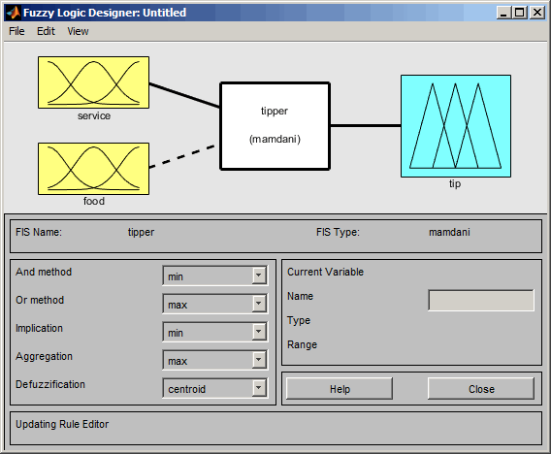
Tipper Problem

Slide 19
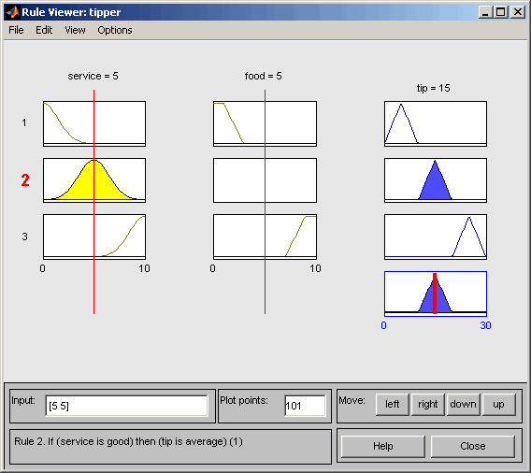

Slide 20
Sample system Demo

Slide 21
Conclusion
Fuzzy Logic provides an alternative way to approach real-world problems in the computing world. It can be easily applied to different applications and control system which can reap long term benefits. Given its ability to work well with variety of problems ,it opens a lot of doors to modern computing.
However, it also has limitations just like other methods when it comes to accuracy and its inability to learn from its failure .

Slide 22


